Slide 1
Analyzing Gender Pay Disparities in Biotech
Course: INT 6940 – Experiential Learning Projects for Professionals
Team Name: Equity Analysts
Team Members: Bo Liu, Nikhil Doye, Tin Tran, Vinith Kumaragurubaran, Vishwadeepsinh Makwana

Slide 2
Dataset Overview
This dataset captures over 2.9 million entries detailing payments from biotech and healthcare companies to professionals across the U.S. Key fields include recipient type, state, specialty, and payment details like amount, form (e.g., cash, in-kind), and purpose (e.g., consulting, travel).
Dataset - 2022
Total Payment Amount for All Companies: $512,122,364
Total Number of Records: 2,954,216
Total Number of Male Recipients: 1,523,507
Total Number of Female Recipients: 1,430,709
Dataset - 2023
Total Payment Amount for All Companies: $325,880,162
Total Number of Records: 3,377,386
Total Number of Male Recipients: 1,672,692
Total Number of Female Recipients: 1,704,694

Slide 3

Project Research
Expanded understanding of gender pay disparity, including both compensation and opportunity gaps.
Addressed the absence of gender data by applying open-source and commercial APIs to classify gender with an accuracy range of 75-85%.
Narrowed down datasets from OpenPayments to top biotech companies based on criteria such as market capitalization and revenue.

Slide 4
Data Challenges and Resolutions
New Challenges and Solutions:
Role and Position Disparities: Males dominate high-paying roles (e.g., Medical Doctors), while females are often in lower-paying roles (e.g., Nurse Practitioners).
High-Value Payment Disparities: Males receive more high-value payments and higher amounts per transaction, suggesting structural disparities.
Data Challenges with Gender-Neutral Names: Collaborated with team to address classification inaccuracies, especially for non-U.S.-origin names.

Slide 5

Current Hurdles
Detailed Challenges:
Industry and Payment Type Biases: Males are more likely to receive higher-value cash payments, whereas females receive more in-kind benefits.
Geographical Impact: State-based disparities in payment amounts, with males receiving higher payments in most states.
Systemic Biases: Observed biases in hiring, promotion, and compensation across roles and companies.

Slide 6
Analysis Insights
Role-Based Payment Disparities: Male-dominated roles have significantly higher average payments.
High-Value Payment Distribution: Male recipients have a greater share of high-value payments, contributing to the overall pay gap

Slide 7
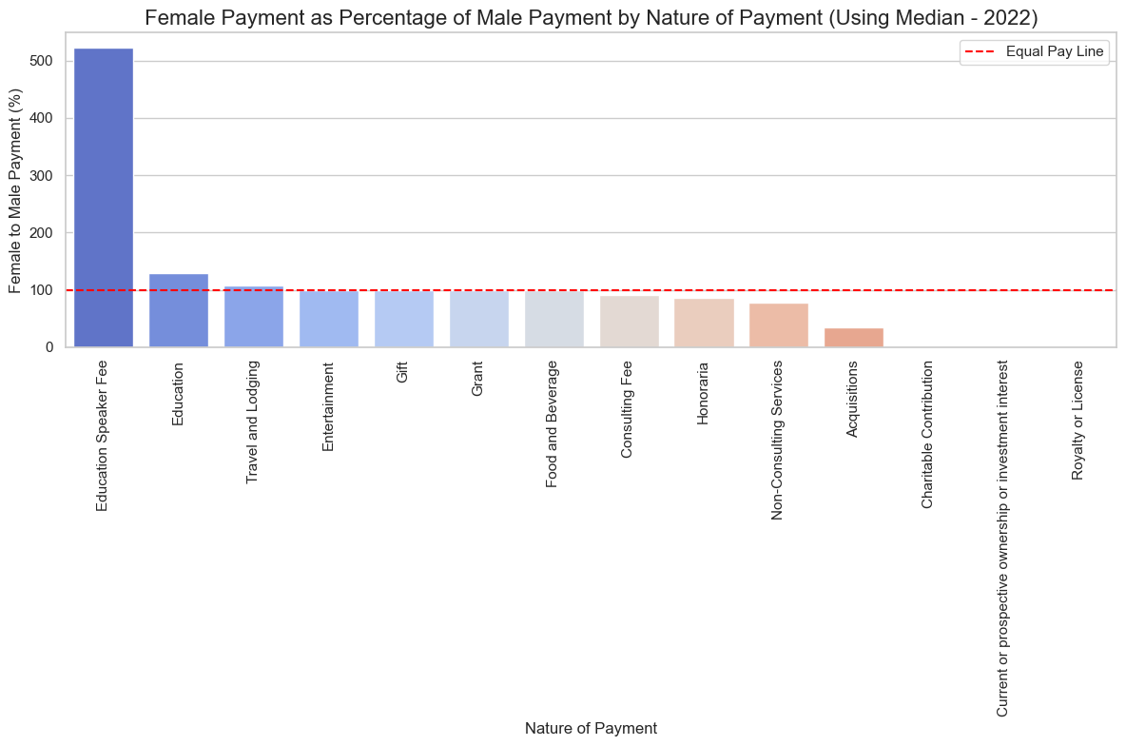
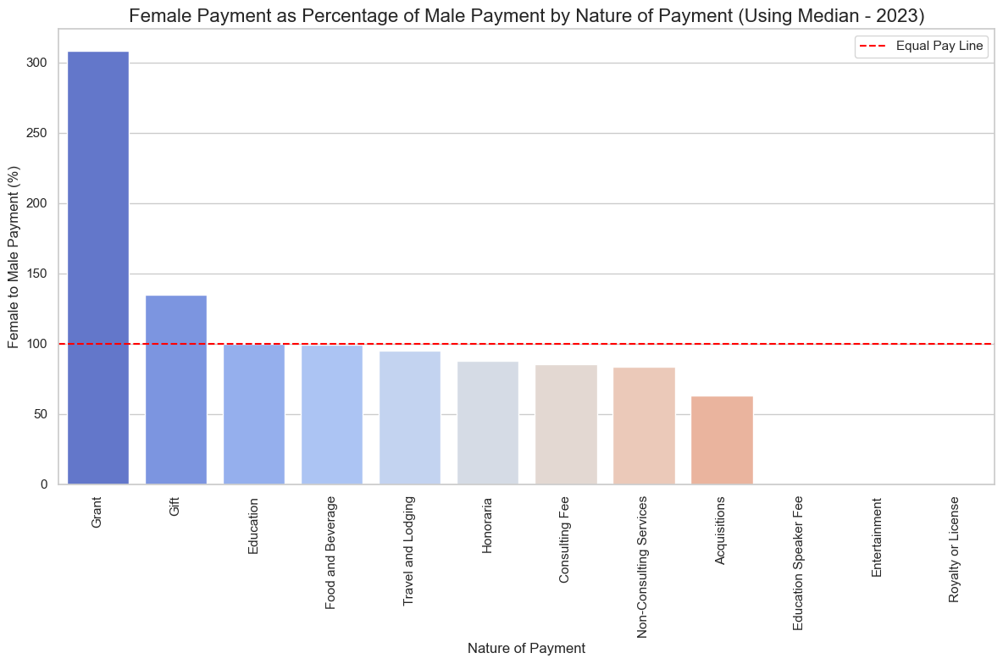
Gender Payment Analysis by Nature and Company (Using Median)

Slide 8
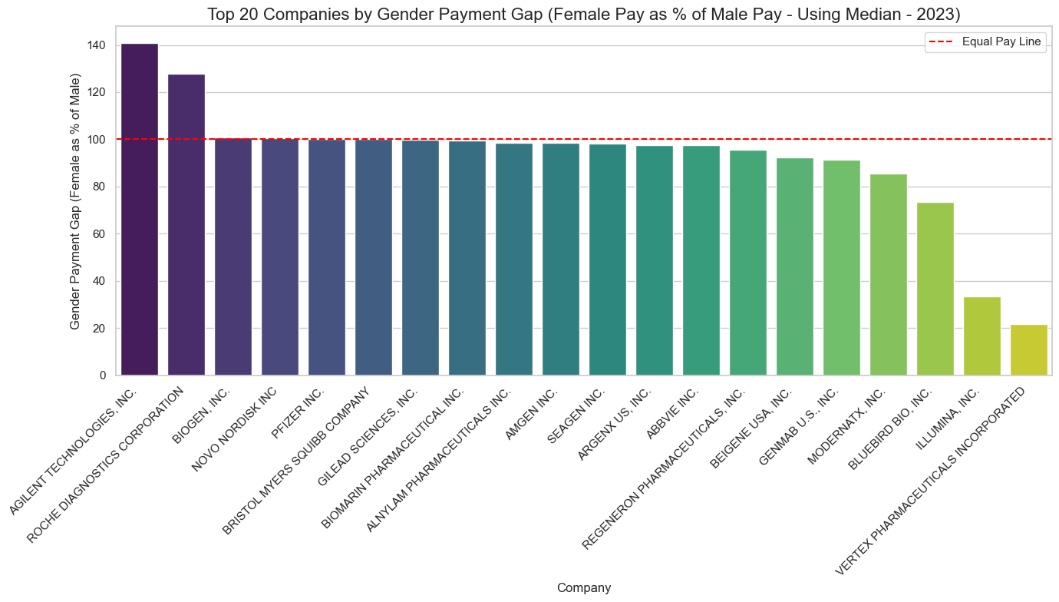
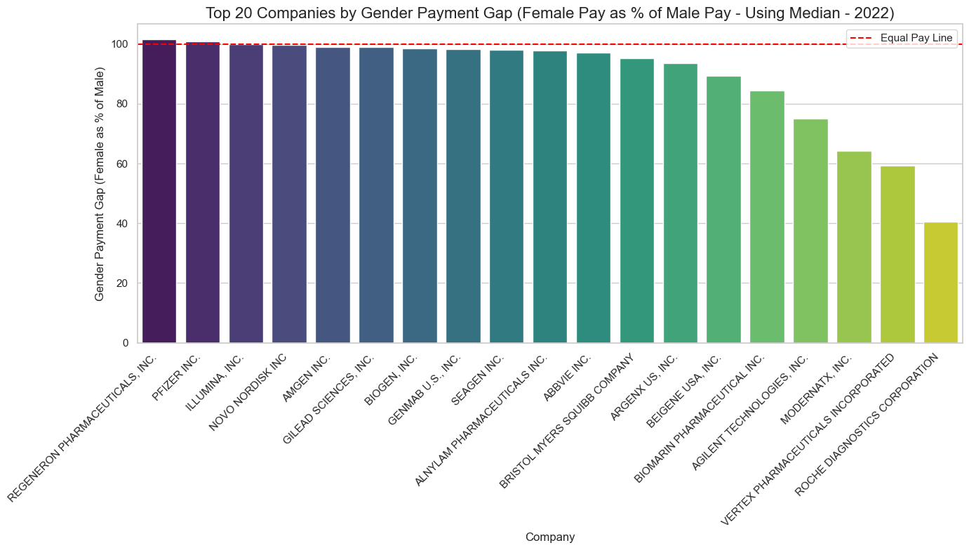
Top 20 companies - Gender Payment Analysis by Company (Using Median)

Slide 9
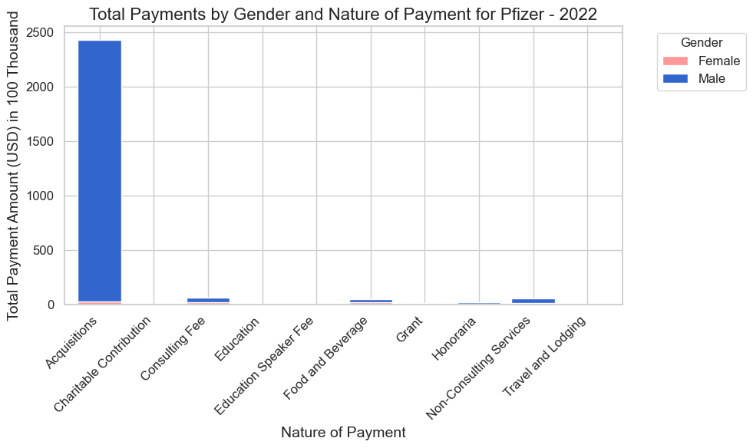
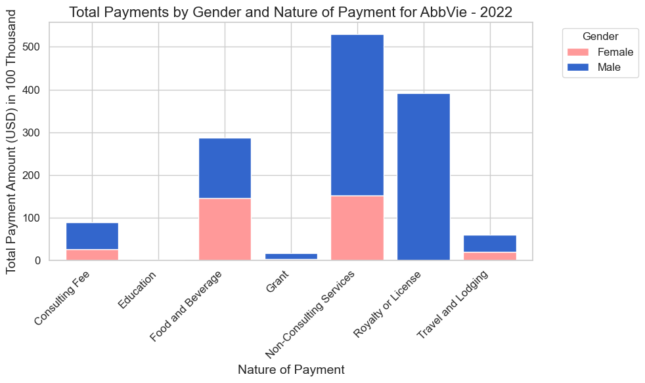
Pfizer’s payment structure is more concentrated and male-dominated, especially in high-value categories, whereas AbbVie demonstrates a wider distribution of payments with better female representation in certain areas.

Slide 10
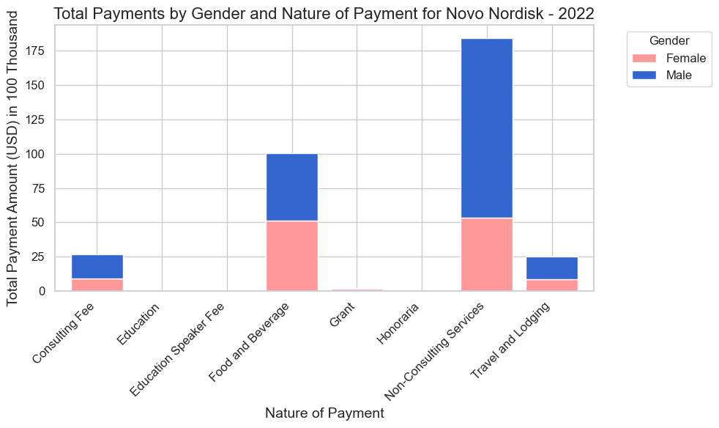
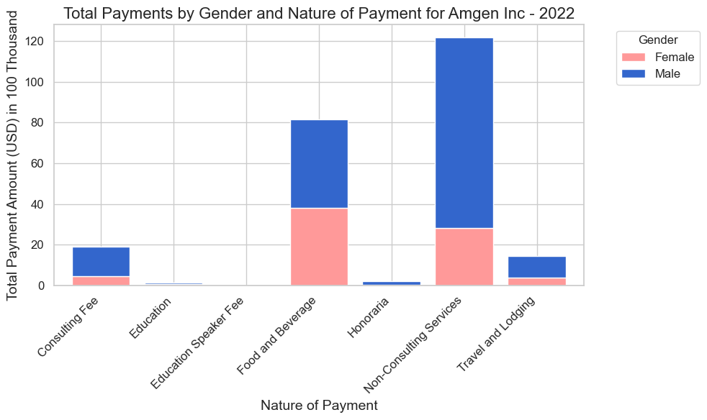
Novo Nordisk and Amgen seems better compared to the gaints like Pfizer but still need to make strong changes for better female representations.

Slide 11
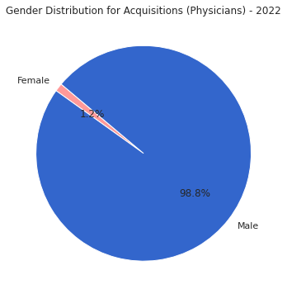
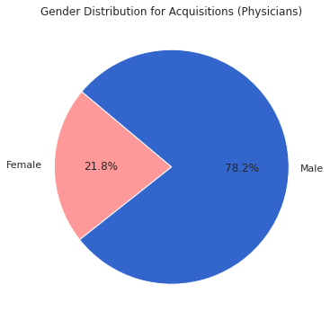
Acquisitions Comparison (2022 vs. 2023)

Slide 12
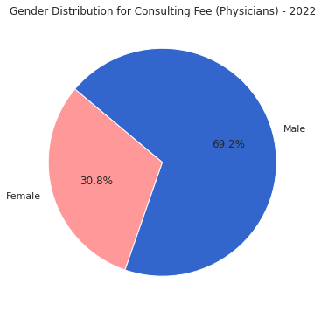
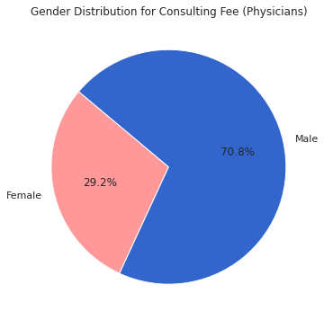
Consulting Fee Comparison (2022 vs. 2023)

Slide 13
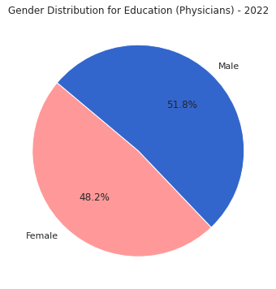
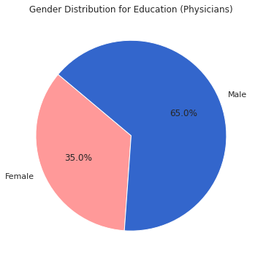
Education Comparison (2022 vs. 2023)

Slide 14
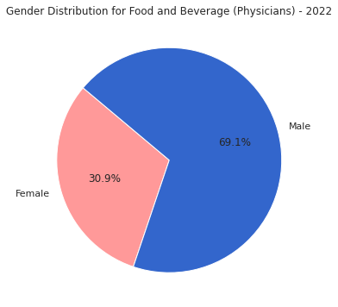
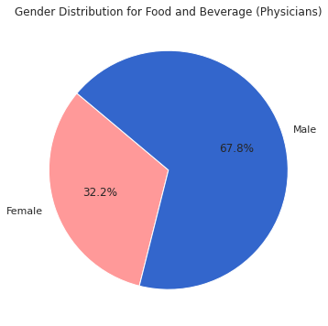
Food Comparison (2022 vs. 2023)

Slide 15
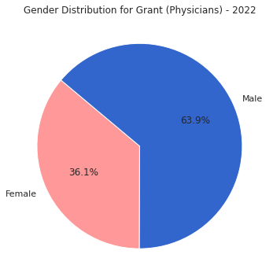
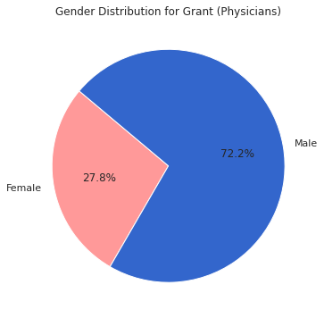
Grant Comparison (2022 vs. 2023)

Slide 16
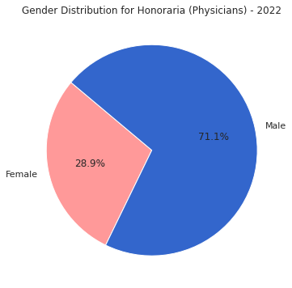

Honoraria, Non-Consulting Services, and Travel & Lodging Comparison (2022 vs. 2023)

Slide 17
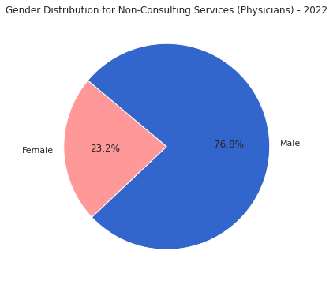
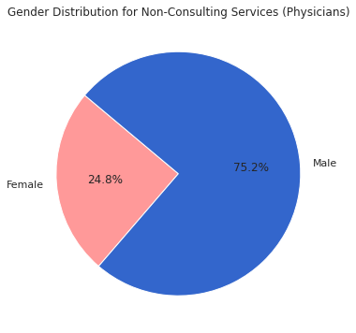
Honoraria, Non-Consulting Services, and Travel & Lodging Comparison (2022 vs. 2023)

Slide 18
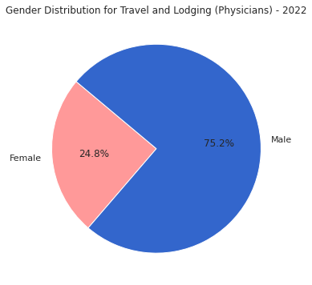
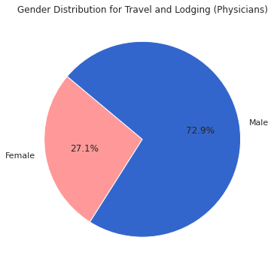
Honoraria, Non-Consulting Services, and Travel & Lodging Comparison (2022 vs. 2023)

Slide 19
Key Observations and Trends (2022 vs. 2023)
Overall Increase in Female Representation: In categories like "Acquisitions" and "Education," there is a noticeable increase in the percentage of female recipients from 2022 to 2023.
Persistent Male Dominance in High-Value Categories: Categories such as "Consulting Fees" and "Grant" still show male dominance, although some female representation is observed.
Shift in Food and Beverage and Travel & Lodging: Minor improvements in gender balance are seen in "Food and Beverage" and "Travel and Lodging," but male recipients continue to receive the majority.
Inconsistent Progress Across Categories: While some categories show progress, others remain largely male-dominated, indicating inconsistent gender equity improvements across payment types.

Slide 20
Recommendations and Next Steps
Targeted Policy Recommendations:
Encourage equitable payment practices in high-value categories like "Consulting Fees" and "Grant" to increase female representation.
Implement gender-focused strategies in companies to ensure balanced payments in categories like "Acquisitions" and "Non-Consulting Services."
Further Data Analysis:
Conduct deeper analysis to identify the underlying causes of disparities in each category.
Examine other factors, such as age and region, for a more comprehensive understanding of the gender payment gap.
Continuous Monitoring:
Recommend annual reviews of payment data to monitor gender equity improvements over time.
Establish benchmarks for gender balance in payment distribution across categories to track progress effectively.

Slide 21

Future Steps
Next Steps:
Collaborate with Two Other Teams: Join efforts to provide broader recommendations across multiple sectors, not limited to biotech.
Cross-Sector Insights and Recommendations: Develop holistic strategies to reduce gender pay disparities by summarizing insights across all sectors.
Final Report Preparation: Integrate findings, visuals, and sector-wide recommendations for the final repor

Slide 22
Questions & Answers

